Slide 1
Ch6.1 Software Architectures Design
——From Logical View to Development View

Slide 2
Component (Package) Design Principles
Reuse-Release Equivalency Principle
Common Closure Principle
Common Reuse Principle
Acyclic Dependencies principles
Stable Dependencies principles
Stable Abstractions principles

Slide 3
Reuse-Release Equivalency Principle (REP)
The unit of reuse is the unit of release
Bob Martin
It is about reusing software
Reuseable software is external software,
you use it but somebody else maintains it.
There is no difference between commercial
and non-commercial external software for reuse.

Slide 4
REP Summary
Group components (classes) for reusers
Single classes are usually not reuseable
  Several collaborating classes make up a package
Classes in a package should form a reuseable and releaseable module
  Module provides coherent functionality
  Dependencies on other packages controlled
  Requirements on other packages specified
Reduces work for the reuser

Slide 5
Common Closure Principle (CCP)
Classes which change together belong together
Bob Martin
Minimise the impact of change for the programmer.
When a change is needed, it is good for the programmer
if the change affects as few packages as possible, because
of compile and link time and revalidation

Slide 6
CCP Summary
Group classes with similar closure together
  package closed for anticipated changes
Confines changes to a few packages
Reduces package release frequency
Reduces work for the programmer

Slide 7
Common Reuse Principle (CRP)
Classes in packages should be reused together
Bob Martin
Packages should be focused, users should
use all classes from a package
CRP for packages is analogous to SRP for classes

Slide 8
CRP Summary
Group classes according to common reuse
  avoid unneccessary dependencies for users
Following the CRP often leads to splitting packages
  Get more, smaller and more focused packages
Reduces work for the reuser

Slide 9
Tradeoffs Between CCP and CRP
CCP and CRP principles are mutually exclusive, i.e. they cannot simultaneously be satisfied.
The CRP makes life easy for reusers, whereas the CCP makes life easier for maintainers.
The CCP strives to make packages as large as possible, whereas the CRP tries to make packages very small.
Early in a project, architects may set up the package structure such that CCP dominates and development and maintenance is aided. Later, as the architecture stabilizes, the architects may refactor the package structure to maximize CRP for the external reusers.

Slide 10
The Acyclic Dependencies Principle (ACP)
The dependency structure for packages must be
a Directed Acyclic Graph (DAG)
Stabilise and release a project in pieces
Avoid interfering developers  Morning after syndrome
Organise package dependencies in a top-down hierarchy

Slide 11
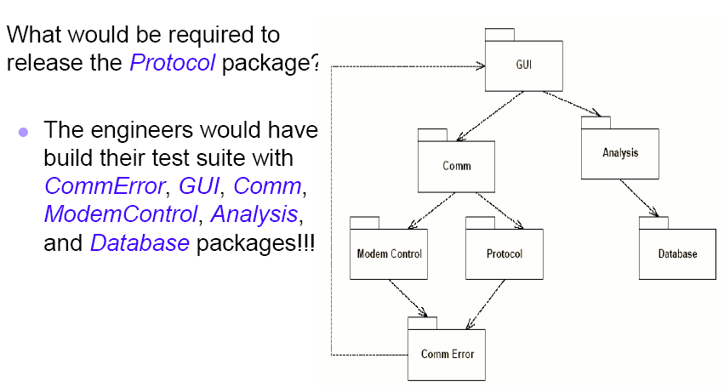
Dependencies are a DAG

Slide 12
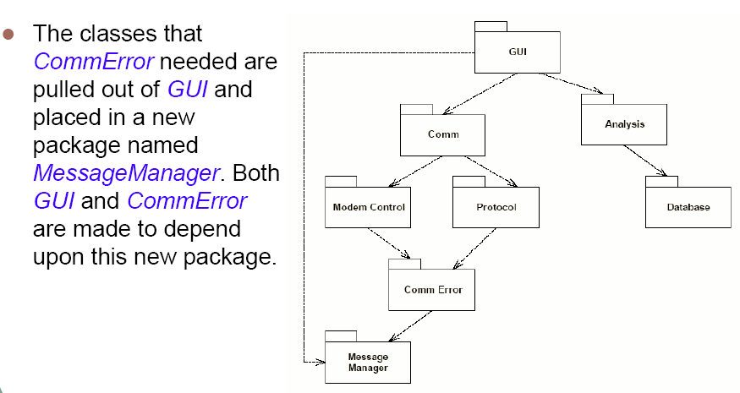
Dependency Cycles
Breaking a Cycle: 1st Way

Slide 13
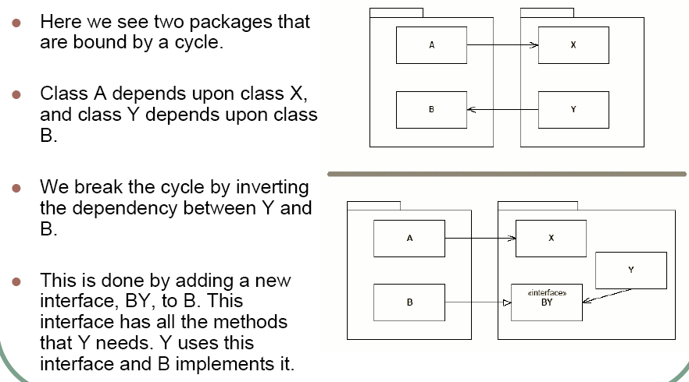
Dependency Cycles
Breaking a Cycle: 2nd Way

Slide 14
Stable Dependencies Principle (SDP)
Dependencies should point in the direction of stability
Robert Martin
Stability: corresponds to effort required to change a package
stable package hard to change within the project
Stability can be quantified

Slide 15
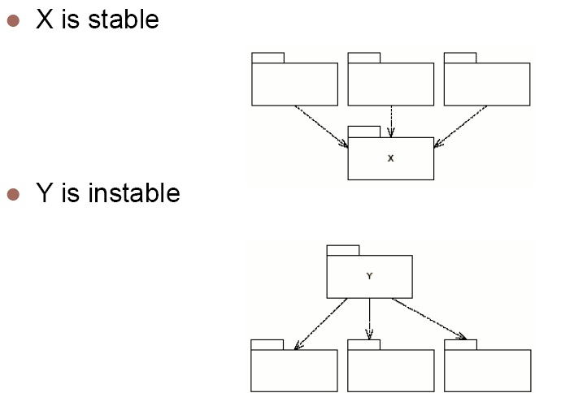
SDP Example

Slide 16
Stable Abstractions Principle (SAP)
Stable packages should be abstract packages.
Unstable packages should be concrete packages.
Robert Martin
Stable packages contain high level design. Making them
abstract opens them for extension but closes them for
modifications (OCP). Some flexibility is left in the stable
hard-to-change packages.

